Slide 1
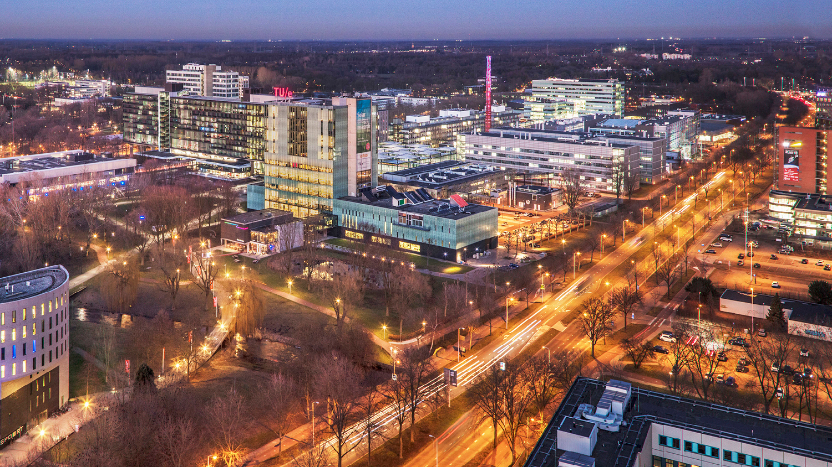
Theoretical Model Accuracy
February 26, 2021
Dolf Eck
4GB10 – Group 7

Slide 2
Contents …
Goal of SSA
New base for MATLAB script
Volume Function
Heat Released Function

Slide 3
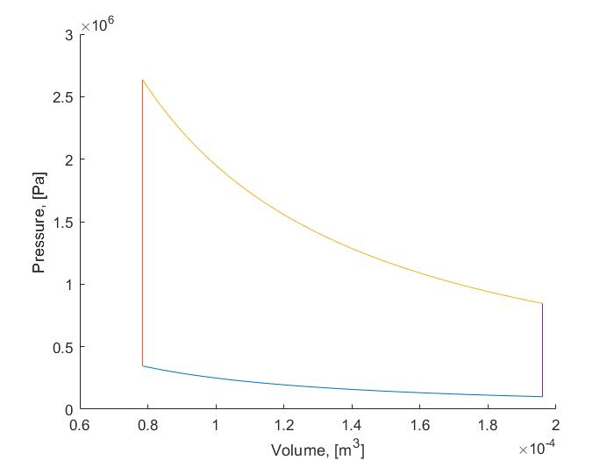
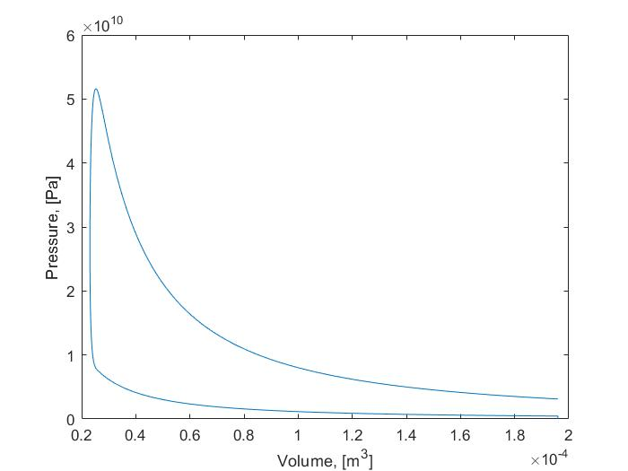
Goal of SSA

Slide 4
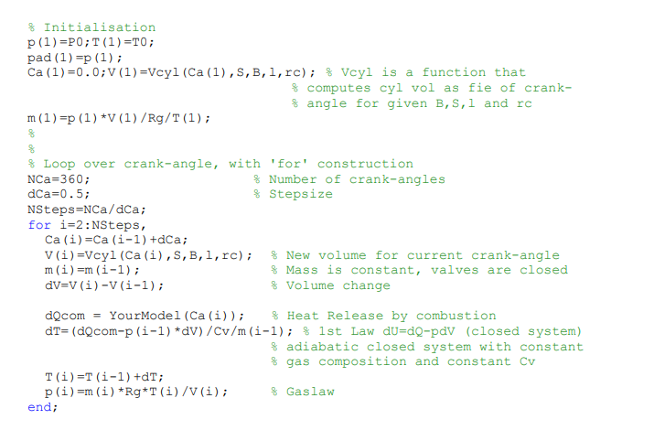
New MATLAB Foundation

Slide 5
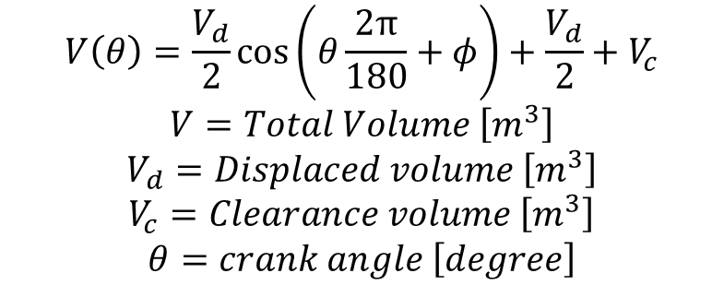
Volume Function
$$V\left(θ\right)=\frac{V_{d}}{2}\cos\left(θ\frac{2π}{180}+φ\right)+\frac{V_{d}}{2}+V_{c}$$
$$V=Total Volume \left[m^{3}\right]$$
$$V_{d}=Displaced volume \left[m^{3}\right]$$
$$V_{c}=Clearance volume \left[m^{3}\right]$$
$$θ=crank angle \left[degree\right]$$

Slide 6
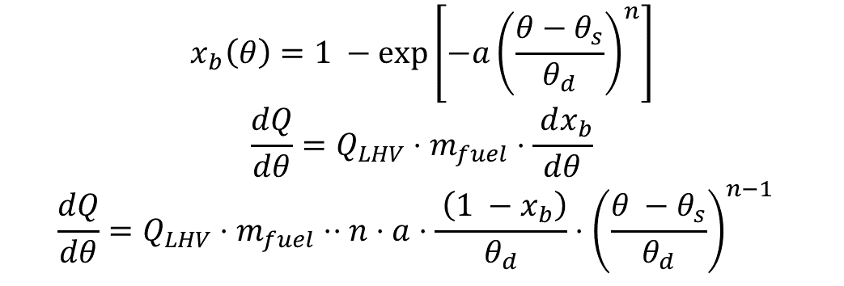
Heat Released formula
$$x_{b}\left(θ\right)=1 −\exp\left[−a{\left(\frac{θ−θ_{s}}{θ_{d}}\right)}^{n}\right]$$
$$\frac{dQ}{dθ}=Q_{LHV}⋅m_{fuel}⋅\frac{ dx_{b}}{dθ}$$
$$\frac{dQ}{dθ}=Q_{LHV}⋅m_{fuel}⋅⋅n⋅a⋅\frac{ \left(1 −x_{b}\right)}{θ_{d}}⋅{\left(\frac{θ −θ_{s}}{θ_{d}}\right)}^{n−1}$$

Slide 7
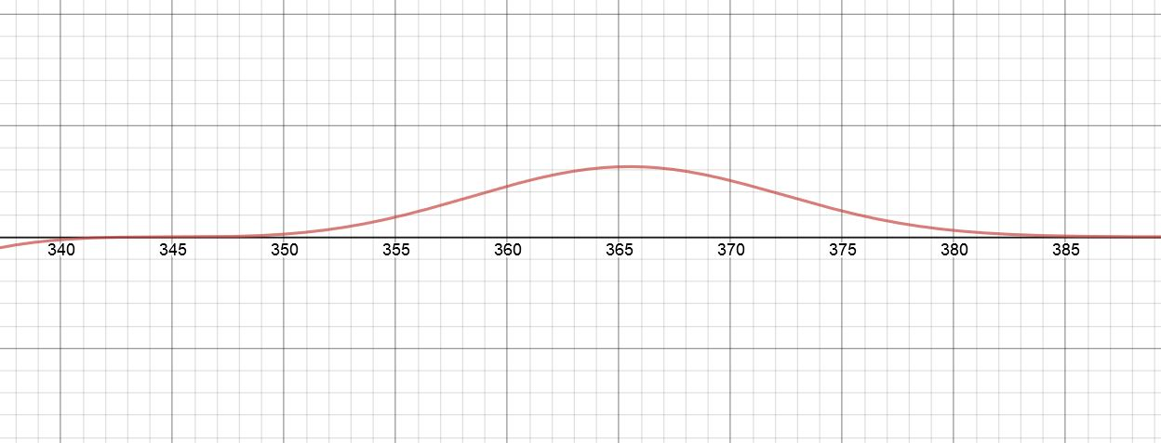
Wiebe function

Slide 8
To do…
Implement losses to the wall
Implement efficiency calculations
Different fuels
Efficiency calculations

